Slide 1
Time-to-First-Spike Identity Mapping
刘沛雨
2025.6.8

Slide 2
Outline
Background
Rate coding & temporal coding
SNN Training
Methods
Time-to-first-spike (TTFS) coding
Two-stage integrate-and-fire (IF) neuron
Identity mapping between ReLU and TTFS Neuron
Gradient flow analysis
Results
Reproduction
Discussion

Slide 3
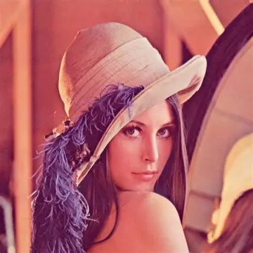



How spikes encode information?
Spike itself does not contain any information
Every spike looks similar in shape
Frequency and timing are important
Through frequency – rate coding
Through timing – temporal coding
rate coding
temporal coding
$$t$$
$$t$$
$$t$$
$$t$$
Background
Methods
Results
Discussion

Slide 4

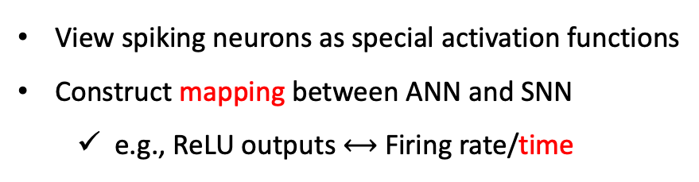
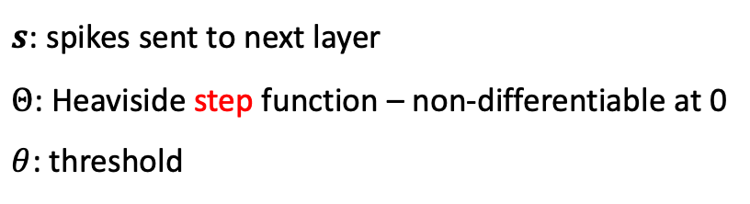
SNN Training
$s$: spikes sent to next layer
$Θ$: Heaviside step function – non-differentiable at 0
$θ$: threshold
Training from scratch
$$s=Θ\left(v\left(t\right)−θ\right)∈\{0,1\}$$
SNN
surrogate gradient
View spiking neurons as special activation functions
Construct mapping between ANN and SNN
e.g., ReLU outputs $⟷$ Firing rate/time
Transform ANN into SNN
Background
Methods
Results
Discussion

Slide 5
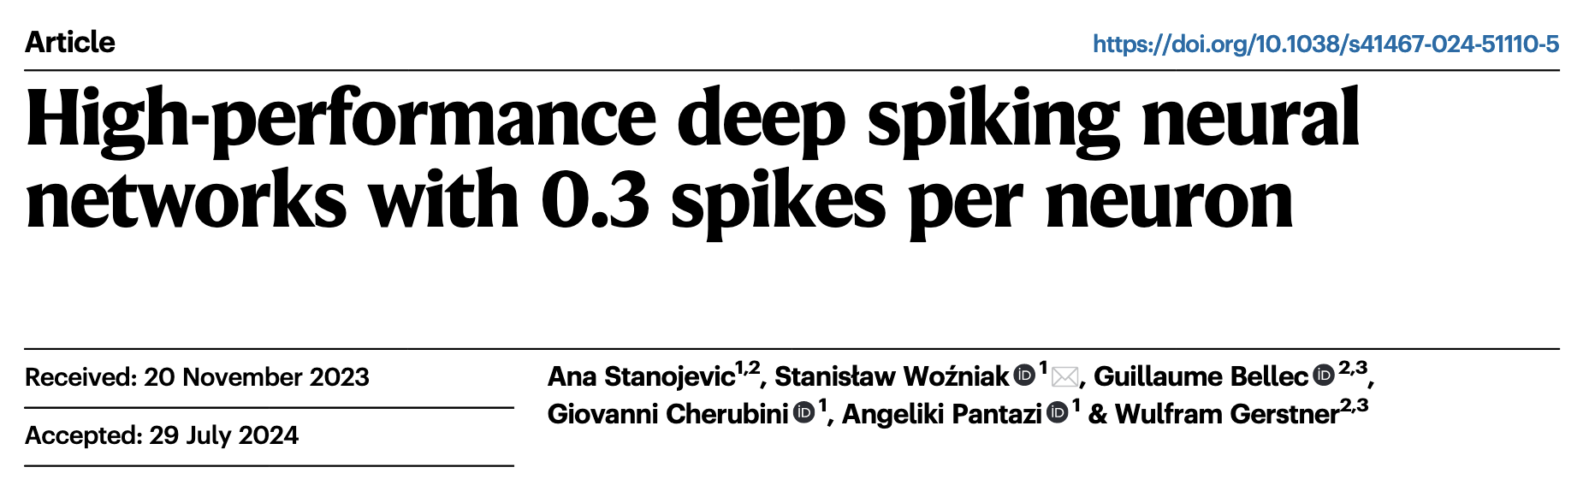
SNN Training
Background
Methods
Results
Discussion

Slide 6
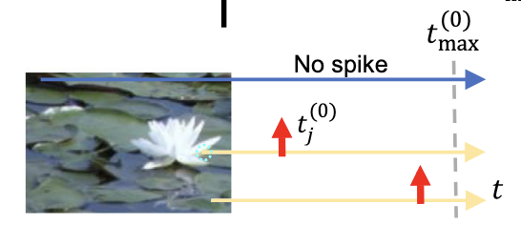
Time-to-First-Spike (TTFS) Coding
High intensity leads to early firing.
Background
Methods
Results
Discussion

Slide 7
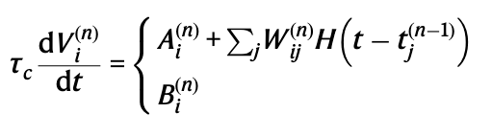
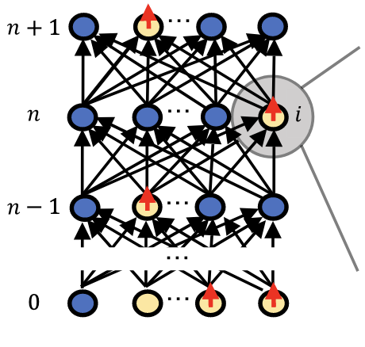
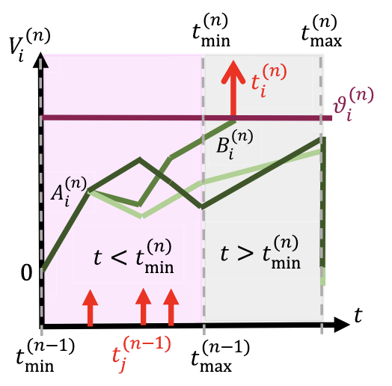
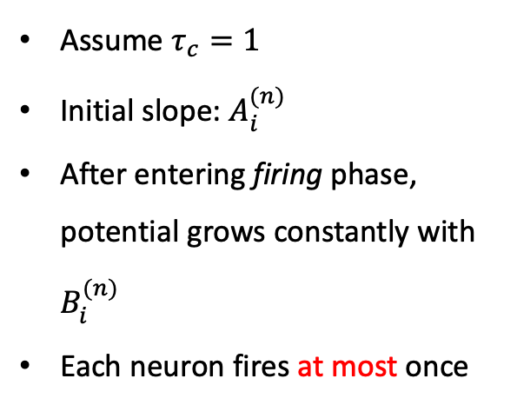
Two-stage IF Neuron
integrating
firing
Assume $τ_{c}=1$
Initial slope: $A_{i}^{(n)}$
After entering firing phase, potential grows constantly with $B_{i}^{(n)}$
Each neuron fires at most once
Feed-Forward Network
Neuronal Dynamics
Background
Methods
Results
Discussion

Slide 8

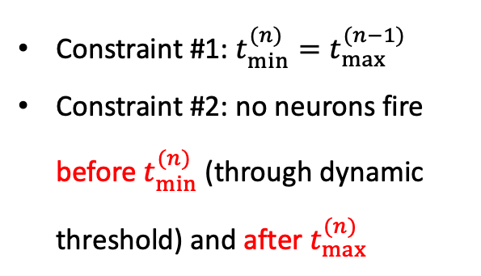
Two-stage IF Neuron
integrating
firing
Constraint #1: $t_{min}^{(n)}=t_{max}^{(n−1)}$
Constraint #2: no neurons fire before $t_{min}^{(n)}$ (through dynamic threshold) and after $t_{max}^{(n)}$
Feed-Forward Network
Neuronal Dynamics
Background
Methods
Results
Discussion

Slide 9
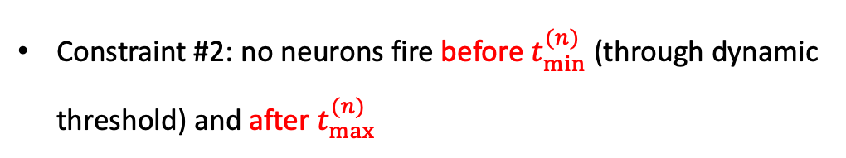






Identity Mapping Between ReLU and TTFS Neuron
$x_{j}^{(n)}$_{(after ReLU)}
$$w_{ij}^{(n)}$$
$$x_{j}^{(n−1)}$$
$${bias}_{i}^{(n)}$$
$$\frac{t_{max}^{(n)}−t_{i}^{(n)}}{τ_{c}}=\sum_{j}{\frac{W_{ij}^{(n)}}{B_{i}^{(n)}}∙}\frac{t_{max}^{(n−1)}−t_{j}^{(n−1)}}{τ_{c}}+\frac{t_{max}^{(n−1)}−t_{min}^{(n−1)}}{τ_{c}}−\frac{θ_{i}^{(n)}}{B_{i}^{(n)}}$$
$$⟺$$
$t_{i}^{(n)}$: time when neuron $i$ in layer $n$ fires (assume it fires).
$A_{i}^{(n)}=0$
Constraint #2: no neurons fire before $t_{min}^{(n)}$ (through dynamic threshold) and after $t_{max}^{(n)}$
A two-stage IF neuron fires in SNN $⟺$ Corresponding ReLU neuron produces a positive output in ANN
Background
Methods
Results
Discussion

Slide 10
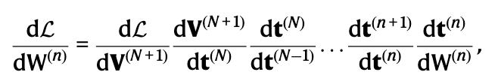
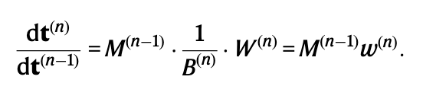







Main Findings - Gradients are still not equivalent.
Pervious research used similar neuron models and methods to derive identity mapping
But only achieved equivalence at initialization
Problems must lie in backpropagation
$x_{j}^{(n)}$_{(after ReLU)}
$$w_{ij}^{(n)}$$
$$x_{j}^{(n−1)}$$
$${bias}_{i}^{(n)}$$
$$\frac{t_{max}^{(n)}−t_{i}^{(n)}}{τ_{c}}=\sum_{j}{\frac{W_{ij}^{(n)}}{B_{i}^{(n)}}∙}\frac{t_{max}^{(n−1)}−t_{j}^{(n−1)}}{τ_{c}}+\frac{t_{max}^{(n−1)}−t_{min}^{(n−1)}}{τ_{c}}−\frac{θ_{i}^{(n)}}{B_{i}^{(n)}}$$
$M^{(n−1)}=diag\left\{m_{1}^{(n)},m_{2}^{(n)},…,m_{N}^{(n)}\right\},m_{i}^{(n)}∈\{0,1\}$ - gradient gating
$B^{(n)}=diag\left\{B_{1}^{(n)},B_{2}^{(n)},…,B_{N}^{(n)}\right\},m_{i}∈\{0,1\}$
$w^{(n)}$: weights in ANN corresponding to $W^{(n)}$ in SNN
Background
Methods
Results
Discussion

Slide 11
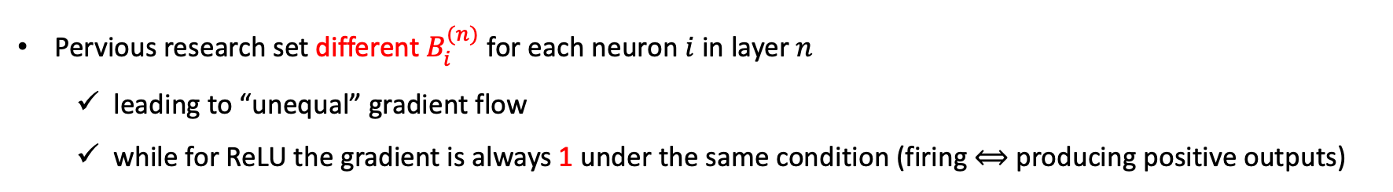
Main Findings - Gradients are equivalent only when $B^{(n)}=1$.
Pervious research set different $B_{i}^{(n)}$ for each neuron $i$ in layer $n$
leading to “unequal” gradient flow
while for ReLU the gradient is always 1 under the same condition (firing $⟺$ producing positive outputs)
$M^{(n−1)}=diag\left\{m_{1}^{(n)},m_{2}^{(n)},…,m_{N}^{(n)}\right\},m_{i}^{(n)}∈\{0,1\}$ - gradient gating
$B^{(n)}=diag\left\{B_{1}^{(n)},B_{2}^{(n)},…,B_{N}^{(n)}\right\},m_{i}∈\{0,1\}$
$w^{(n)}$: weights in ANN corresponding to $W^{(n)}$ in SNN
Background
Methods
Results
Discussion

Slide 12
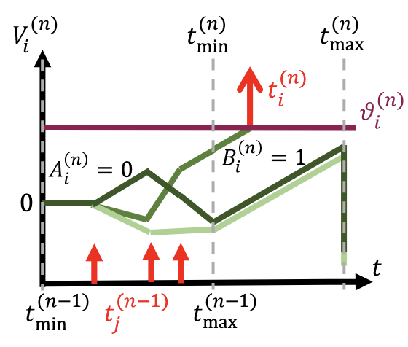
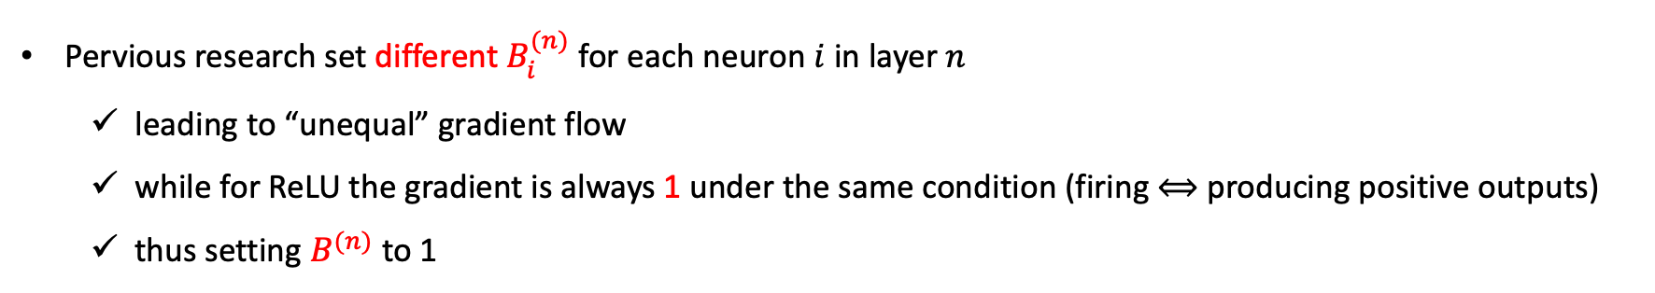
Main Findings - Gradients are equivalent only when $B^{(n)}=1$.
Pervious research set different $B_{i}^{(n)}$ for each neuron $i$ in layer $n$
leading to “unequal” gradient flow
while for ReLU the gradient is always 1 under the same condition (firing $⟺$ producing positive outputs)
thus setting $B^{(n)}$ to 1
Background
Methods
Results
Discussion

Slide 13
Performance on MNIST
Model | Arch. | Test acc. [%] (from paper) | Test acc. [%] (reproduced)
ReLU | FC2 | 98.30 | 98.38
TTFS | FC2 | 98.30 | 98.40
ReLU | FC16 | 98.43 ± 0.07 | 98.14
TTFS | FC16 | 98.43 ± 0.07 | 98.16
ReLU | VGG16 | 99.57 ± 0.01 | 99.59
TTFS | VGG16 | 99.58 ± 0.01 | 99.50
Background
Methods
Results
Discussion

Slide 14
Performance on FashionMNIST
Model | Arch. | Test acc. [%] (from paper) | Test acc. [%] (reproduced)
ReLU | FC2 | 90.14 | 90.22
TTFS | FC2 | 90.14 | 90.31
ReLU | LeNet5 | 90.91 ± 0.17 | 90.73
TTFS | LeNet5 | 90.94 ± 0.25 | 90.80
Implementation is based on PyTorch; Codes will be released on GitHub
Background
Methods
Results
Discussion

Slide 15
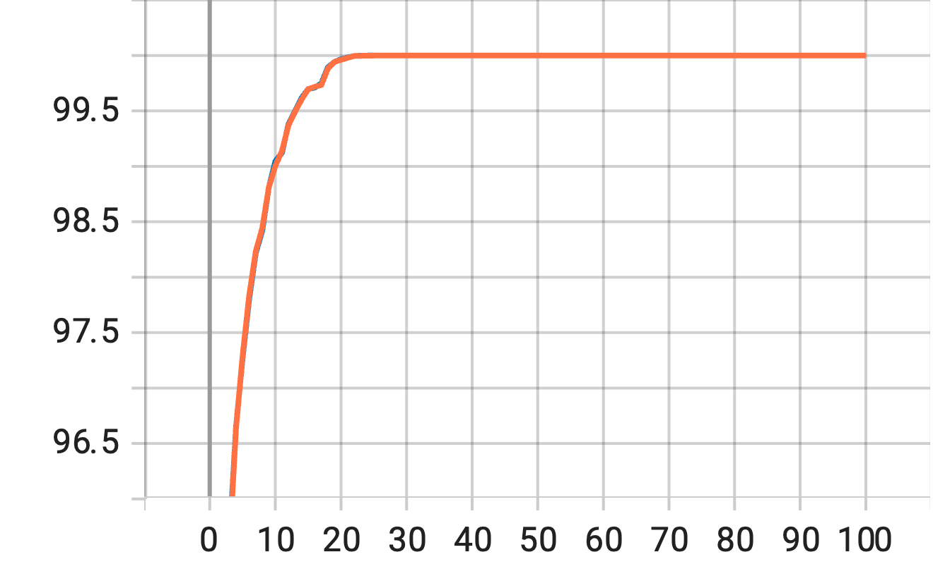
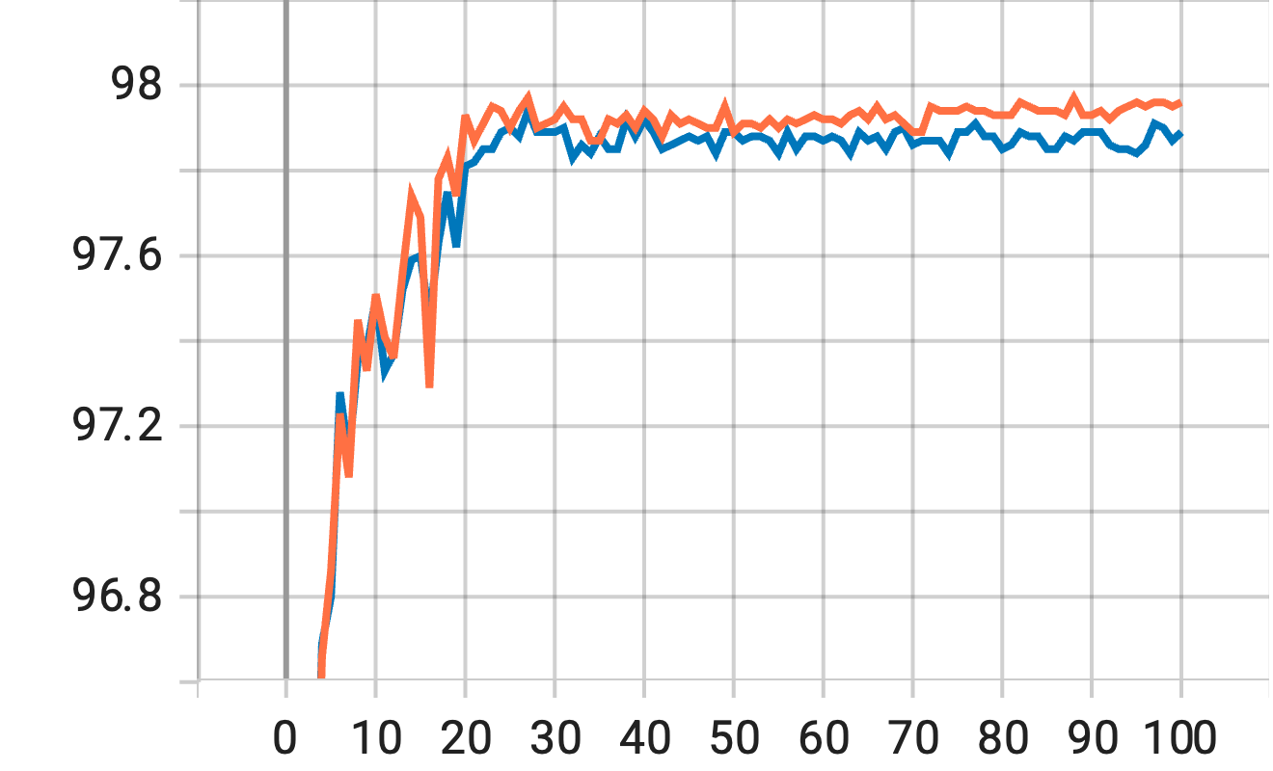
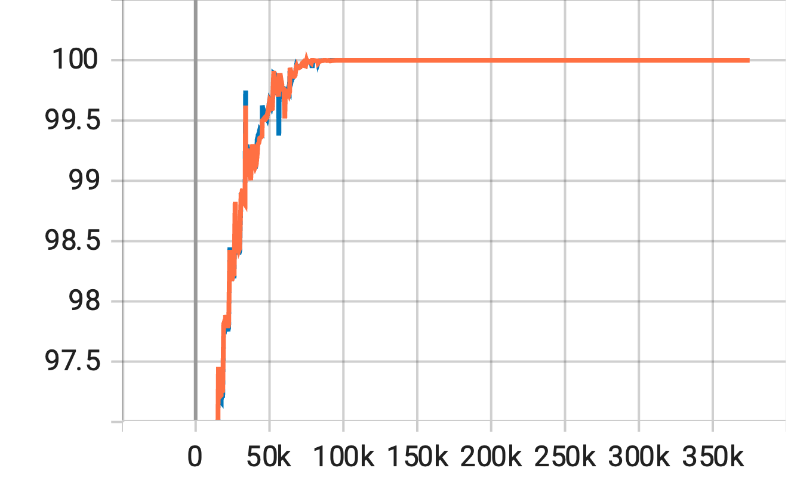
Training Equivalence (demo. on a 8-layer MLP)
Acc.
Acc.
train
Acc.
epoch
test
epoch
TTFS
ReLU
iteration
Background
Methods
Results
Discussion

Slide 16
Discussion
Summary
Potential in the firing phase scales the gradients during backpropogation
Always make sure that these potential has same gradient with that of ANN activation functions
Future work
Reproduction
Visualization
Testing on larger benchmarks (e.g., CIFAR10/100, ImageNet, PLACE365, etc.)
Robustness tests
ANN2SNN conversion in TTFS
Other possible directions
Implementing TTFS on ResNet
Better Compatibility with BatchNorm
Background
Methods
Results
Discussion

Slide 17
Reference
Stanojevic A. et al. High-performance deep spiking neural networks with 0.3 spikes per neuron. Nat Commun. 2024 Aug 9;15(1):6793.
Stanojevic A. et al. An exact mapping from ReLU networks to spiking neural networks. Neural Netw. 2023 Nov;168:74-88.

Slide 18

Thank you!

Slide 19
Q&A

